Slide 1
By- 1.Ritik Sharma 2.Rahul Choudhary 3.Rajiv
Tiffin Service
Under the supervision of : Dr. Gurpreet Singh
Chitkara University Institute of Engineering and Technology (CUIET)
Chitkara University , Punjab

Slide 2



INTRODUCTION
“
The project is a online food delivery service that enables the user to get delievered his/her favourite food at home
THE PROJECT IS MADE USING PYTHON .
2

Slide 3
PROBLEM STATEMENT
Problem faced by people was that there was not so good option for them to
order their food online. There was also not any good website and portal
available which delivers food fast and provide good quality.

Slide 4
OBJECTIVE :
“
In this project, our objective is to provide user the benefits online so that the user can order food fast and of good quality.
6

Slide 5

METHODOLOGY
WE FOLLOWED CERTAIN STEPS TO BUILD THIS PROJECT :
First we imported the required modules of python like Time and OS .
Our next step was to define the function to generalise the structure of food list.
And, finally we created the project which displays the food list , items , bill, payment etc.
7

Slide 6


REFERENCES :
REFERENCES ALWAYS PLAY A KEY ROLE IN RECREATING SOMETHIMG FROM SCRATCH.
WE HAVE ALSO TAKEN HELP FROM WEBSITES LIKE Google WHILE BUILDING THIS PROJECT
9

Slide 7
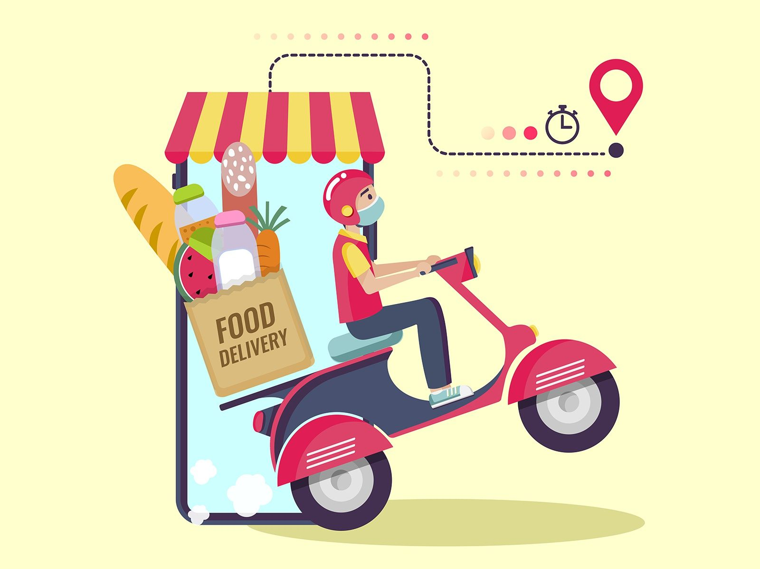
Online Food
Delivery
ORDER NOW!
10

Slide 8

t

